Slide 1
21CSC201J DATA STRUCTURES AND ALGORITHMS
UNIT-5 Topic :PRIM’S ALGORITHM

Slide 2
Introduction
Prim's algorithm to find minimum cost spanning tree (as Kruskal's algorithm) uses the greedy approach. Prim's algorithm shares a similarity with the shortest path first algorithms.
Prim's algorithm, in contrast with Kruskal's algorithm, treats the nodes as a single tree and keeps on adding new nodes to the spanning tree from the given graph.

Slide 3
Contd…
Step1: Select any connected vertices with minimum weight.
Step2: Select unvisited vertex which is adjacent to visited vertices with minimum weight.
Step3: Repeat step2 until all vertices are visited.

Slide 4
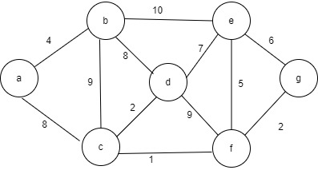
Example:

Slide 5
Step1:
Visited vertices S={a}
Remaining verticesV/S ={b,c,d,e,f,g}
Connected vertices A={}
Lightest edges ={a,b}
a

Slide 6
Step2:
S={a,b}
V/S= {c,d,e,f,g}
A={a,b}
Lightest edge={b,d}
There are two edges {a,b} and {a,c}. Since {a,b} having minimum weight it is considered.
b
4
a

Slide 7
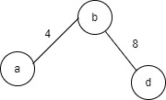
Step3:
S={a,b,d}
V/S={c,e,f,g}
A={{a,b},{b,d}}
Lightest edge= {d,c}

Slide 8
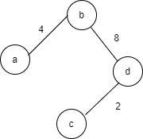
Step4:
S={a,b,c,d}
V/S ={e,f,g}
A={{a,b},{b,d},{d,c}}
Lightest edges={e,f}
{b,c} will form a loop
so it is not considered.

Slide 9
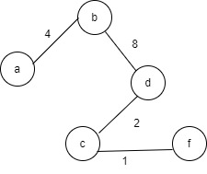
Step5:
S={a,b,c,d,f}
V/S={e,g}
A={{a,b},{b,d},{d,c},{c,f}}
Lightest edge={f,g}

Slide 10
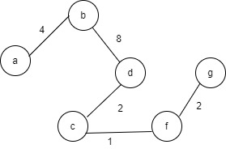
Step6:
S={a,b,c,d,f,g}
V/S={e}
A={{a,b},{b,d},{d,c},{c,f},{f,g}}
Lightest edge={g,e}
{f,d} will form a loop
so it is not considered

Slide 11
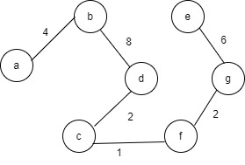
Step7:
S={a,b,c,d,e,f,g,f}
V/S={}
Connected vertices
A={{a,b},{b,d},{d,c},
{c,f},{f,g},{g,e}}

Slide 12
Final Minimum Spanning Tree

Slide 13
Minimum spanning Tree = a-b-d-c-f-g-e
Total cost= 4+8+2+1+2+6
=23

Slide 14
Algorithm
This algorithm creates spanning tree with minimum weight from a given weighted graph. Begin
Create edge list of given graph, with their weights.
Draw all nodes to create skeleton for spanning tree.
Select an edge with lowest weight and add it to skeleton and delete edge from edge list.
Add other edges. While adding an edge take care that the one end of the edge should always be in the skeleton tree and its cost should be minimum.
Repeat step 5 until n-1 edges are added.
Return.

Slide 15
#include <stdio.h>
#define Vertices 5
//A utility function for finding the vertex with the lowest key value from a set of vertices that isn't included in MST.
int Least_Key(int key[], bool Min_Span_Tree[])
{
int least = INT_MAX, min_index;
for (int v = 0; v < Vertices; v++)
if (Min_Span_Tree[v] == false && key[v] < least)
least = key[v], min_index = v;
return min_index;
}
//Function to print created MST
int print_Prims_MST(int parent[], int graph[Vertices][Vertices])
{
printf("Edge \tWeight\n");
for (int i = 1; i < Vertices; i++)
printf("%d - %d \t%d \n", parent[i], i, graph[i][parent[i]]);
}

Slide 16
//Function to generate MST
void prims_MST(int graph[Vertices][Vertices])
{
int parent[Vertices];
int key[Vertices];
bool Min_Span_Tree[Vertices];
for (int i = 0; i < Vertices; i++)
key[i] = INT_MAX, Min_Span_Tree[i] = false;
key[0] = 0;
parent[0] = -1;
for (int count = 0; count < Vertices - 1; count++) {
int u = Least_Key(key, Min_Span_Tree);
Min_Span_Tree[u] = true;
for (int v = 0; v < Vertices; v++)
if (graph[u][v] && Min_Span_Tree[v] == false && graph[u][v] < key[v])
parent[v] = u, key[v] = graph[u][v];
}
printf("Created Spanning Tree for Given Graph is: \n");
printf("\n");
print_Prims_MST(parent, graph);
}

Slide 17
int main()
{
int graph[Vertices][Vertices] = { { 0, 3, 0, 6, 0 },
{ 3, 0, 4, 8, 5 },
{ 0, 4, 0, 0, 7 },
{ 6, 8, 0, 0, 11 },
{ 0, 5, 7, 11, 0 } };
prims_MST(graph);
return 0;
}

